Slide 1
Heap sort
23/07/04

Slide 2
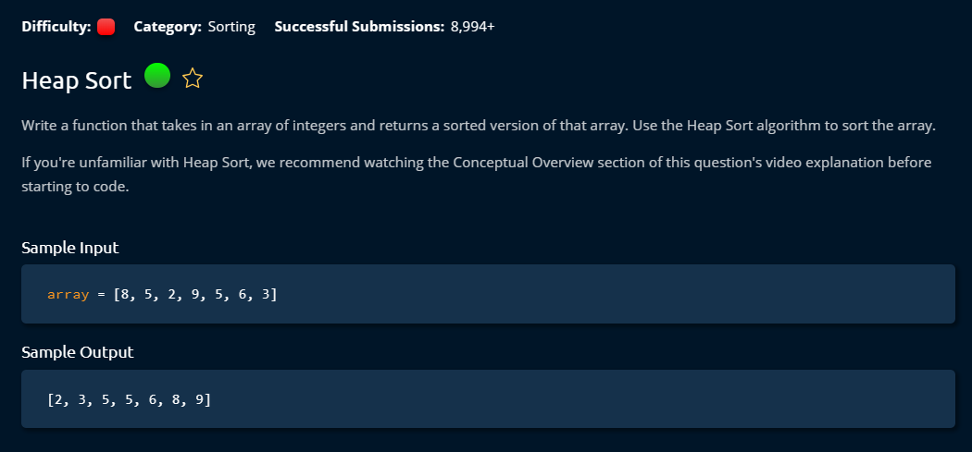

Slide 3
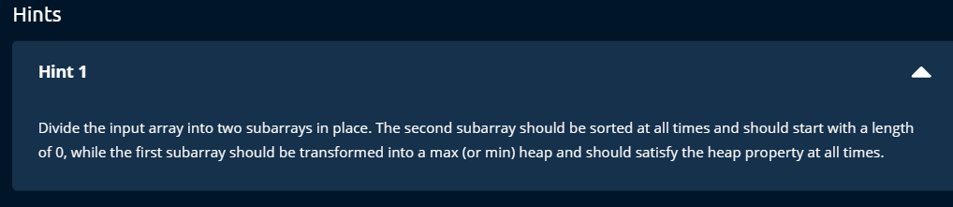

Slide 4
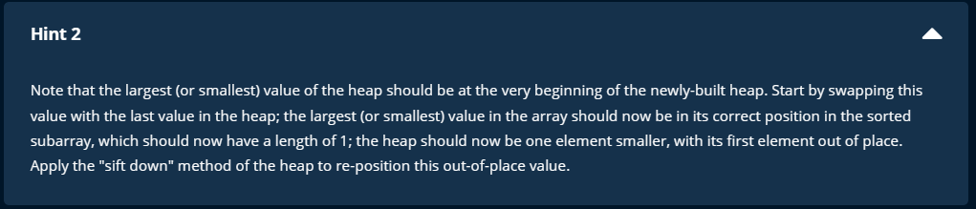

Slide 5
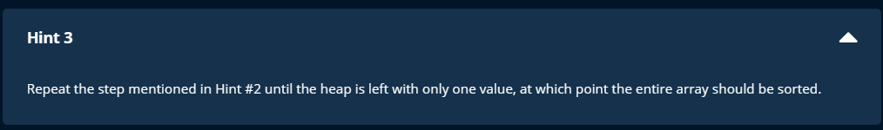

Slide 6
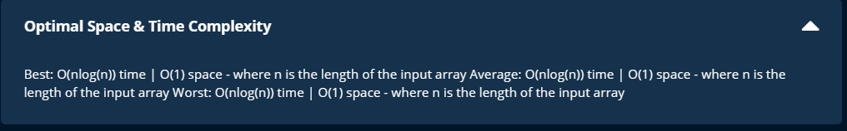

Slide 7
If you can build heap, then you can do heap sort.
Check min heap construction for building heap.

Slide 9
Steps
Build a max heap first
Move the largest value to the final index
That takes place in the original array. >> to get space O(1)

Slide 10
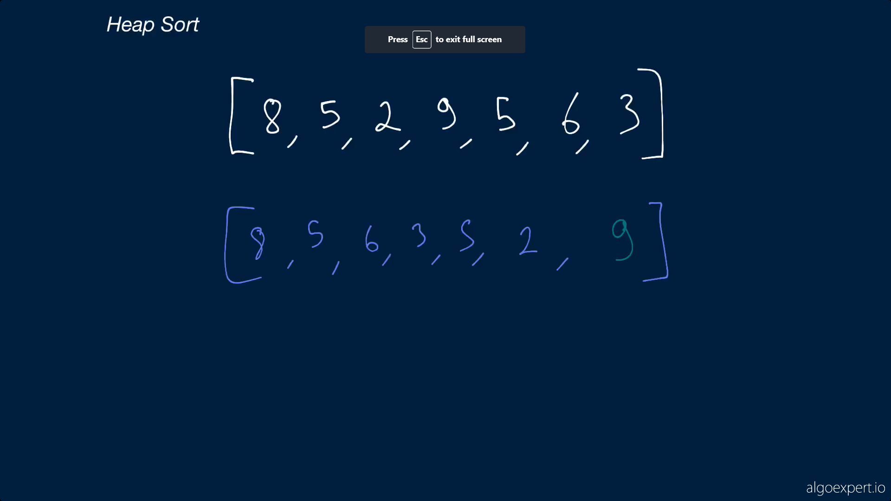

Slide 11
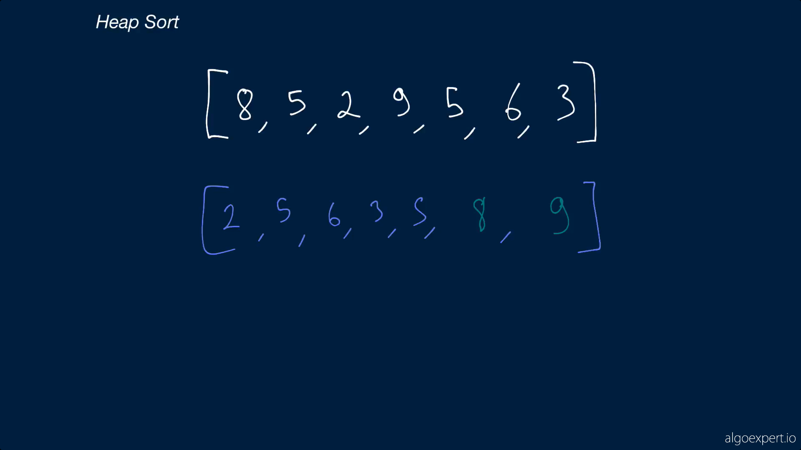

Slide 12
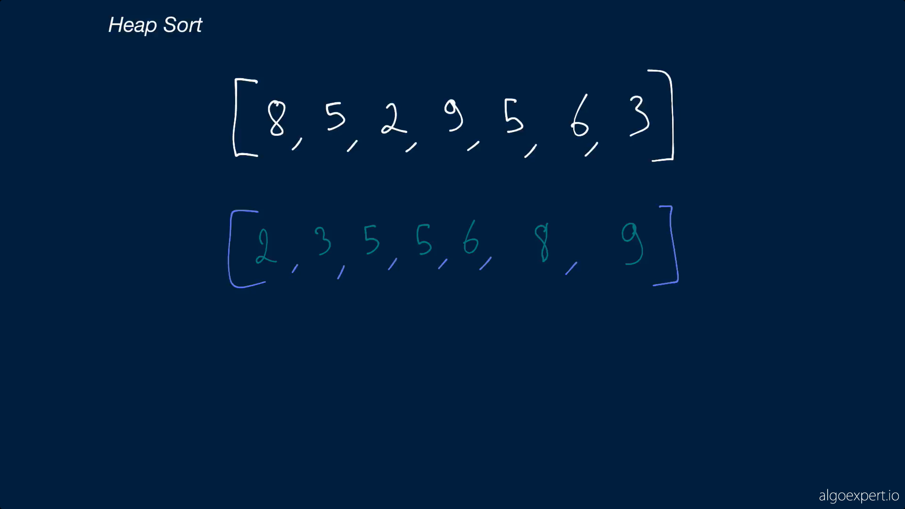

Slide 13
